Slide 1
502045
Software Engineering
Chapter 03
Lesson 03: Requirement Process

Slide 2
Topics covered
Define Requirement
Functional and non-functional requirements
Requirement specification
Requirements engineering processes:
Requirements elicitation and analysis
Requirements validation
Requirements management
Develop SRS (The software requirements document )
Notes:
Elicitation: suy luận, moi ra

Slide 3
What is a requirement?
It may range from a high-level abstract statement of a service or of a system constraint to a detailed mathematical functional specification.
This is inevitable as requirements may serve a dual function
May be the basis for a bid for a contract - therefore must be open to interpretation;
May be the basis for the contract itself - therefore must be defined in detail;
Both these statements may be called requirements.

Slide 4
Types of requirement
User requirements
Statements in natural language plus diagrams of the services the system provides and its operational constraints. Written for customers.
System requirements
A structured document setting out detailed descriptions of the system’s functions, services and operational constraints. Defines what should be implemented so may be part of a contract between client and contractor(nguoinhanthau).

Slide 5
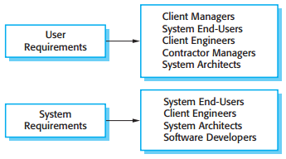
Readers of different types of requirements specification

Slide 6
Topics covered
Define Requirement
Functional and non-functional requirements
Requirement specification
Requirements engineering processes:
Requirements elicitation and analysis
Requirements validation
Requirements management
Develop SRS (The software requirements document )
Notes:
Elicitation: suy luận, moi ra

Slide 7
Functional requirements
Describe functionality or system services.
Depend on the type of software, expected users and the type of system where the software is used.
Functional user requirements may be high-level statements of what the system should do.
Functional system requirements should describe the system services in detail.

Slide 8
Requirements imprecision
Problems arise when requirements are not precisely stated.
Ambiguous requirements may be interpreted in different ways by developers and users.
Consider the term ‘search’ in requirement 1
User intention – search for a patient name across all appointments in all clinics;
Developer interpretation – search for a patient name in an individual clinic. User chooses clinic then search.
Example???

Slide 9
Non-functional requirements implementation
Non-functional requirements may affect the overall architecture of a system rather than the individual components.
For example, to ensure that performance requirements are met, you may have to organize the system to minimize communications between components.
A single non-functional requirement, such as a security requirement, may generate a number of related functional requirements that define system services that are required.
It may also generate requirements that restrict existing requirements.

Slide 10
Non-functional classifications (Self Study)
Product requirements
Requirements which specify that the delivered product must behave in a particular way e.g. execution speed, reliability, etc.
Organisational requirements
Requirements which are a consequence of organisational policies and procedures e.g. process standards used, implementation requirements, etc.
External requirements
Requirements which arise from factors which are external to the system and its development process e.g. interoperability requirements, legislative requirements, etc.

Slide 11
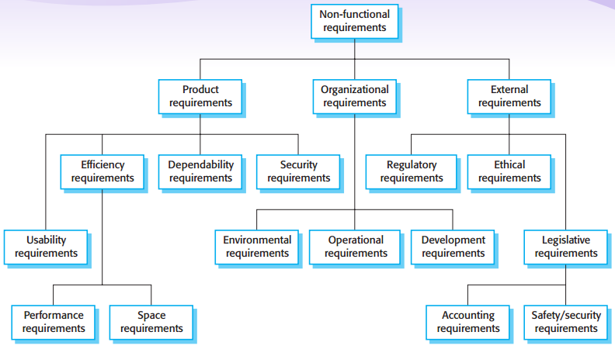
Types of NF (Self Study)

Slide 12
Goals and requirements
A common problem with non-functional requirements is that users or customers often propose these requirements as general goals, such as ease of use, the ability of the system to recover from failure, or rapid user response.
Whenever possible, you should write non-functional requirements quantitatively so that they can be objectively tested
Goals are helpful to developers as they convey^{[truyền-đạt]} the intentions^{[ý-đồ]} of the system users.

Slide 13
Metrics for specifying nonfunctional requirements
Property | Measure
Speed | Processed transactions/second User/event response time Screen refresh time
Size | Mbytes Number of ROM chips
Ease of use | Training time Number of help frames
Reliability | Mean time to failure Probability of unavailability Rate of failure occurrence Availability
Robustness | Time to restart after failure Percentage of events causing failure Probability of data corruption on failure
Portability | Percentage of target dependent statements Number of target systems
Notes:
Robustness: Doben

Slide 14
Topics covered
Define Requirement
Functional and non-functional requirements
Requirement specification
Requirements engineering processes:
Requirements elicitation and analysis
Requirements validation
Requirements management
Develop SRS (The software requirements document )
Notes:
Elicitation: suy luận, moi ra

Slide 15
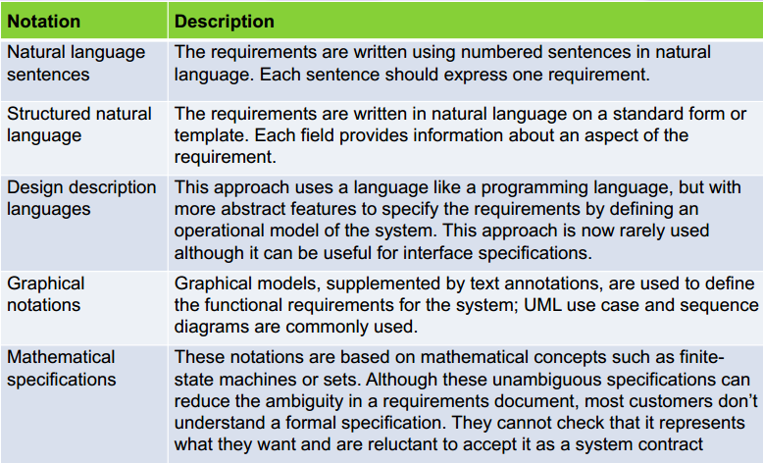
How to write

Slide 16
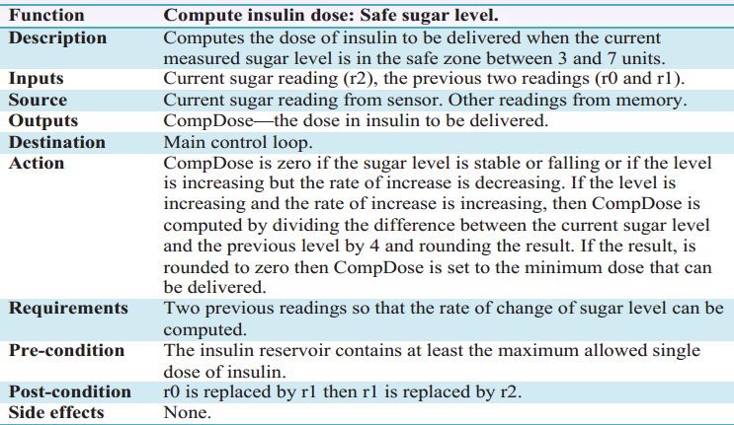
Example
Notes:
Elicitation: suy luận, moi ra

Slide 17
Discussion (10’)

Slide 18
Topics covered
Define Requirement
Functional and non-functional requirements
Requirement specification
Requirements engineering processes:
Requirements elicitation and analysis
Develop SRS (The software requirements document )
Requirements validation
Requirements management
Notes:
Elicitation: suy luận, moi ra

Slide 19
Requirements elicitation and analysis
Sometimes called requirements elicitation [tìm thấy] or requirements discovery.
Involves technical staff working with customers to find out about the application domain, the services that the system should provide and the system’s operational constraints.
May involve end-users, managers, engineers involved in maintenance, domain experts, trade unions, etc. These are called stakeholders.

Slide 20
Problems of requirements analysis
Stakeholders don’t know what they really want.
Stakeholders express requirements in their own terms.
Different stakeholders may have conflicting requirements.
Organisational and political factors may influence the system requirements.
The requirements change during the analysis process. New stakeholders may emerge^{[xuất-hiện]} and the business environment may change.
Notes:
Stakeholders: các bên liên quan

Slide 21
Requirements elicitation and analysis
Software engineers work with a range of system stakeholders to find out about the application domain, the services that the system should provide, the required system performance, hardware constraints, other systems, etc.
Stages include:
Requirements discovery,
Requirements classification and organization,
Requirements prioritization and negotiation(damphan),
Requirements specification.

Slide 22
Topics covered
Define Requirement
Functional and non-functional requirements
Requirement specification
Requirements engineering processes:
Requirements elicitation and analysis
Develop SRS (The software requirements document )
Requirements validation
Requirements management
Notes:
Elicitation: suy luận, moi ra

Slide 23
The software requirements document - SRS
The software requirements document is the official statement of what is required of the system developers should implement.
Should include both a definition of user requirements and a specification of the system requirements.
It is NOT a design document. As far as possible, it should set of WHAT the system should do rather than HOW it should do it.

Slide 24
Agile methods and requirements (Self Study)
Many agile methods argue that producing a requirements document is a waste of time as requirements change so quickly.
The document is therefore always out of date.
Methods such as XP use incremental requirements engineering and express requirements as ‘user stories’ (discussed in Chapter 3).
This is practical for business systems but problematic for systems that require a lot of pre-delivery analysis (e.g. critical systems) or systems developed by several teams.

Slide 25
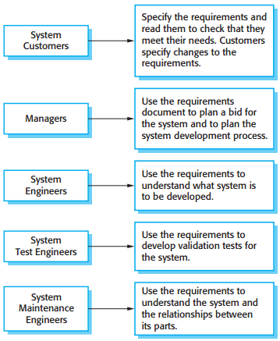
Users of a requirements document
Notes:
The diversity of possible users means that the requirements document has to be a
compromise between communicating the requirements to customers, defining the
requirements in precise detail for developers and testers, and including information
about possible system evolution. Information on anticipated changes can help system designers avoid restrictive design decisions and help system maintenance engineers who have to adapt the system to new requirements.

Slide 26
Requirements document variability
Information in requirements document depends on type of system and the approach to development used.
Systems developed incrementally will, typically, have less detail in the requirements document.
Requirements documents standards have been designed e.g. IEEE standard. These are mostly applicable to the requirements for large systems engineering projects.

Slide 27
The structure of a requirements document
Chapter | Description
Preface | This should define the expected readership^{[độc-giả]} of the document and describe its version history, including a rationale^{[lý-do]} for the creation of a new version and a summary of the changes made in each version.
Introduction | This should describe the need for the system. It should briefly describe the system’s functions and explain how it will work with other systems. It should also describe how the system fits into the overall business or strategic objectives of the organization commissioning the software.
Glossary | This should define the technical terms used in the document. You should not make assumptions about the experience or expertise of the reader.
User requirements definition | Here, you describe the services provided for the user. The nonfunctional system requirements should also be described in this section. This description may use natural language, diagrams, or other notations that are understandable to customers. Product and process standards that must be followed should be specified.
System architecture | This chapter should present a high-level overview of the anticipated system architecture, showing the distribution of functions across system modules. Architectural components that are reused should be highlighted.
Notes:
Preface: Lời nói đầu
Glossary: bảng thuật ngữ, chú giải

Slide 28
The structure of a requirements document
Chapter | Description
System requirements specification | This should describe the functional and nonfunctional requirements in more detail. If necessary, further detail may also be added to the nonfunctional requirements. Interfaces to other systems may be defined.
System models | This might include graphical system models showing the relationships between the system components and the system and its environment. Examples of possible models are object models, data-flow models, or semantic data models.
System evolution | This should describe the fundamental assumptions on which the system is based, and any anticipated changes due to hardware evolution, changing user needs, and so on. This section is useful for system designers as it may help them avoid design decisions that would constrain likely future changes to the system.
Appendices | These should provide detailed, specific information that is related to the application being developed; for example, hardware and database descriptions. Hardware requirements define the minimal and optimal configurations for the system. Database requirements define the logical organization of the data used by the system and the relationships between data.
Index | Several indexes to the document may be included. As well as a normal alphabetic index, there may be an index of diagrams, an index of functions, and so on.
Notes:
Appendices: phụ lục
Index: Mục lục

Slide 29
Requirement Process Develop SRS – Techniques
Specify requirements using structured natural language (forms, tables, etc.)
Functional requirements can be specified using modeling - a combination of graphical notations and structured natural language
Use cases, Use case diagrams, Use case specification
Activity Diagram, State Diagram
DFD, Concept ERD
Prototype: Screen Flow, Screen spec specification
...
Non-functional requirements can’t be modeled => specified using structured natural language only

Slide 30
Requirement Process Develop SRS – Characteristics of good SRS 1/2
Correct: requirement ~ what the software shall meet.
Unambiguous:
Has only one interpretation (to both creator & user)
Use natural language & avoid the words like: maybe, generally, etc.
Complete
Include all significant requirements.
Define all the software responses & include all the refs/labels.
Use of TBD: should avoid OR mention why, what to do, who, when.

Slide 31
Requirement Process Develop SRS - Characteristics of good SRS 2/2
Consistent: no conflict between individual requirements.
Verifiable: reviewable & testable in finite cost-effective process.
Traceable: clear origin & good reference for future develop/enhance documents.
Notes:
Verifiable: có thể kiểm tra

Slide 32
Requirement Process Develop SRS – SRS Review Checklist
SRS Review Checklist
To review the requirements by yourself
Make sure you understood completely the requirements:
Organization and Completeness: adequate, no missing, etc.
Correctness: no conflict, verifiable, in scope, message, etc.
Non-functional requirements, quality attributes, etc.

Slide 33
Topics covered
Define Requirement
Functional and non-functional requirements
Requirement specification
Requirements engineering processes:
Requirements elicitation and analysis
Develop SRS (The software requirements document )
Requirements validation
Requirements management
Notes:
Elicitation: suy luận, moi ra

Slide 34
Requirement Process Validate Requirements – Purpose
Make sure that the requirements define the system that the customer really wants
Requirements error costs are high so validation is very important
Fixing a requirements error after delivery may cost up to 100 times the cost of fixing an implementation error

Slide 35
Requirement Process Validate Requirements – Process
Validity check
Consistency check
Completeness check
Realism check
Verifiability check
Notes:
Validity check
A user may think that a system is needed to perform certain functions. However, further thought and analysis may identify additional or different functions that are required. Systems have diverse stakeholders with distinct needs and any set of requirements is inevitably a compromise across the stakeholder community.
Does the system provide RIGHT functionalities as customer’s NEED?
Consistency check
Requirements in the document should not conflict. That is, there should be no contradictory constraints or descriptions of the same system function.
Is there any requirement CONFLICT?
Completeness check
The requirements document should include requirements which define all functions, and constraints intended by the system user.
Are all functions required by customer INCLUDED?
Is there any common checklists that you can use?
Realism check
Using knowledge of existing technology, the requirement should be checked to ensure that they could actually be implemented. These checks should also take account of the budget and schedule for the system development.
Can requirement be IMPLEMENTED with given available budget and technology?
Verifiability check (in FSOFT process ~ acceptance criteria – a part in SRS)
To reduce the potential for dispute between customer and contractor, system requirements should always be written so that t hey are verifiable. This means that you should be able to write a set of tests that can demonstrate that the delivered system meets each specified requirement.
Can requirement be TESTED?
Xác nhận yêu cầu là một quá trình kiểm tra rằng những yêu cầu có thực sự định nghĩa được hệ thống mà khách hàng thực sư mong muốn. Nó trùng lắp với phân tích vì nó liên quan đến việc tìm kiếm các vấn đề của yêu cầu. Xác nhận yêu cầu thì quan trọng bởi vì những lỗi trong tài liệu yêu cầu có thể dẫn đến chi phí mở rộng để làm lại một khi những vấn đề này được phát hiện trong quá trình phát triển hay khi hệ thống đã được sử dụng.
Chi phí để sửa một vấn đề yêu cầu bằng cách tạo ra một thay đổi hệ thống thì thường lớn hơn sửa thiết kế hoặc lỗi lập trình. Nguyên nhân của điều này là một thay đổi đến yêu cầu phần mềm thường liên có nghĩa rằng thiết kế hệ thống và việc cài đặt phải thay đổi theo. Hơn nữa hệ thống cũng phải được test lại.
Trong suốt quá trình xác nhận yêu cầu, các loại kiểm tra khác nhau nên được đưa ra bao gồm:
Validity checks (kiểm tra hiệu lực): một user có thể nghĩ rằng một hệ thống thì cần để thực thi một chức năng nhất định. Tuy nhiên, suy nghĩ và phân tích sâu hơn có thể xác định chức năng khác hoặc những chức năng thêm cũng bắt buộc phải có. Hệ thống có nhiều stakeholders với những nhu cầu khác nhau và bất kỳ tập yêu cầu nào
Consistency checks: yêu cầu bên trong document không nên mâu thuẫn.
Completeness checks: tài liệu yêu cầu nên bao gồm các yêu cầu mà định nghĩa tất cả chức năng và ràng buộc bởi người dùng hệ thống
Realism checks: Sử dụng kiến thức về những công nghệ hiện có, yêu cầu nên được kiểm tra để bảo đảm rằng chúng có khả năng hiên thực được. Những checks này nên có trong chi phí và thời gian của việc phát triển hệ thống
Varifiability: để giảm thiểu tranh chấp tiềm tàng giữa khách hàng và nhà phát triển, yêu cầu hệ thống nên luôn luôn được viết sao cho chúng có thể kiểm chứng được. Cái này có nghĩa là chúng ta nên viết một tập các tests cái mà minh họa hệ thống khi bàn giao đáp ứng mỗi yêu cầu xác định

Slide 36
Topics covered
Define Requirement
Functional and non-functional requirements
Requirement specification
Requirements engineering processes:
Requirements elicitation and analysis
Develop SRS (The software requirements document )
Requirements validation
Requirements management (Self Study)
Notes:
Elicitation: suy luận, moi ra

Slide 37
Requirements management
Requirements management is the process of managing changing requirements during the requirements engineering process and system development.
New requirements emerge as a system is being developed and after it has gone into use.
You need to keep track of individual requirements and maintain links between dependent requirements so that you can assess the impact of requirements changes. You need to establish a formal process for making change proposals and linking these to system requirements.

Slide 38
Changing requirements (Self Study)
The business and technical environment of the system always changes after installation.
New hardware may be introduced, it may be necessary to interface the system with other systems, business priorities may change (with consequent changes in the system support required), and new legislation and regulations may be introduced that the system must necessarily abide by.
The people who pay for a system and the users of that system are rarely the same people.
System customers impose requirements because of organizational and budgetary constraints. These may conflict with end-user requirements and, after delivery, new features may have to be added for user support if the system is to meet its goals.

Slide 39
Requirement Process Requirements management
Manage requirement
Requirement Management Sheet, Excel sheet, used to track the status, relationship and change of requirements during the whole project.
A mandatory document (dynamic version of SRS)
Classify requirement to functional/non-functional requirement
To maintain the common reference for all related parties (traceability of requirement and software product)
To track the project progress (status of requirement)
To track the change (including change request)
To collect requirement related metrics for reporting
The sheet is created the first time client requirement come
Refer: Template_Requirement Management Sheet.xls

Slide 40
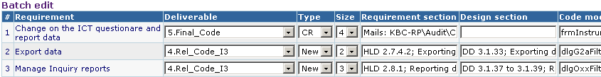
Requirement Process Manage Traceability & Requirement Status
Why is traceability necessary?
The requirements can change at any stage during the product’s life.
If the requirements are traceable, then when changes happen, it is far easier to find the impacted parts of the product
User Needs
Software
Requirements
Work
Products
Software
Requirements
Use cases/
User Requirements
Test cases
Notes:
Trainer show sample of RMS here and introduce overview about this document.

Slide 41
Requirements management planning
Establishes the level of requirements management detail that is required.
Requirements management decisions:
Requirements identificationEach requirement must be uniquely identified so that it can be cross-referenced with other requirements.
A change management processThis is the set of activities that assess the impact and cost of changes. I discuss this process in more detail in the following section.
Traceability policiesThese policies define the relationships between each requirement and between the requirements and the system design that should be recorded.
Tool supportTools that may be used range from specialist requirements management systems to spreadsheets and simple database systems.

Slide 42
Requirements management planning (Self Study)
You need tool support for
Requirements storage The requirements should be maintained in a secure, managed data store that is accessible to everyone involved in the requirements engineering process
Change management The process of change management is simplified if active tool support is available
Traceability management As discussed above, tool support for traceability allows related requirements to be discovered. Some tools are available which use natural language processing techniques to help discover possible relationships between requirements.

Slide 43
Requirement Process Manage Requirements Changes & Status (Self Study)
Requirements change (CR – Change request)
The priority of requirements from different viewpoints changes during the development process
Customers may specify requirements from a business perspective that conflict with end-user requirements
The business and technical environment of the system changes during its development
Requirements change process

Slide 44
Requirements change management (Self study)
Deciding if a requirements change should be accepted
Problem analysis and change specification
During this stage, the problem or the change proposal is analyzed to check that it is valid. This analysis is fed back to the change requestor who may respond with a more specific requirements change proposal, or decide to withdraw the request.
Change analysis and costing
The effect of the proposed change is assessed using traceability information and general knowledge of the system requirements. Once this analysis is completed, a decision is made whether or not to proceed with the requirements change.
Change implementation
The requirements document and, where necessary, the system design and implementation, are modified. Ideally, the document should be organized so that changes can be easily implemented.

